Slide 1
Ready to Launch
An Animated PowerPoint Template

Slide 2
Animated Content Page
This page contains a video element and is optimized to work with PowerPoint 2008 - 2011

Slide 3
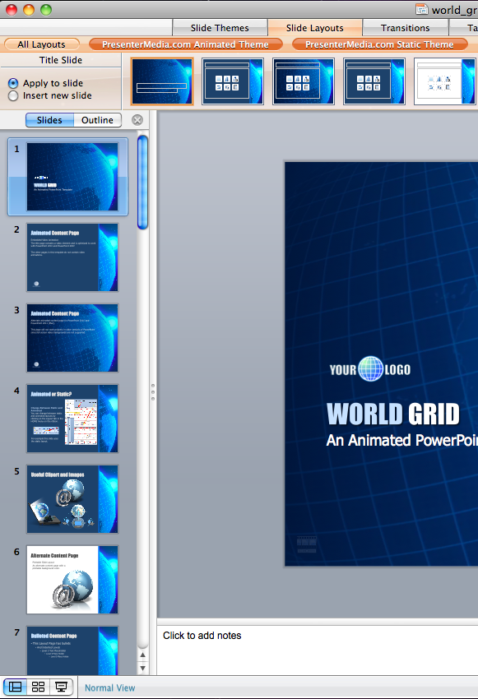
Animated or Static?
You can change between static and animated layouts by clicking on the Slide Layouts tab

Slide 4
Useful Images and Icons

Slide 5
Agenda or Summary Layout
A second line of text could go here
1
Discussion Item One – A Placeholder for text Add a second line of text here
2
Discussion Item Two – A Placeholder for text Add a second line of text here
3
Discussion Item Three – A Placeholder for text Add a second line of text here
4
Discussion Item Four – A Placeholder for text Add a second line of text here

Slide 6
Bar Graph Page Layout
Here is the description of the graph. This chart is compatible with PowerPoint 2008 - 2011.
Here is some more text. You may delete the graphical elements.

Slide 7
Bar Graph Page Layout
Here is the description of the graph. This chart is compatible with PowerPoint 2008 - 2011.
Here is some more text. You may delete the graphical elements.
*note*
Double Click on Charts to Change Color.

Slide 8
Sample Table Layout
Geographic Region | Q1 | Q2 | Q3 | Q4
United States | 1254 | 1254 | 1254 | 1254
Europe and Asia | 324 | 324 | 324 | 324
Australia | 32 | 32 | 32 | 32
South America | 2 | 2 | 2 | 2
Canada | 1 | 1 | 1 | 1
Mexico | 1 | 1 | 1 | 1
TOTALS | 1614 | 1614 | 1614 | 1614
Here is the description of the graph. This chart is compatible with PowerPoint 2008 - 2011.
Here is some more text. You may delete the graphical elements.

Slide 9
Example Pie Graph
Here is the description of the graph. This chart is compatible with PowerPoint 2008 - 2011.
Here is some more text. You may delete the graphical elements.

Slide 10
Example Pie Graph
Here is the description of the graph. This chart is compatible with PowerPoint 2008 - 2011.
Here is some more text. You may delete the graphical elements.
Post notes and reminders
Here.

Slide 11
Comparison Page
Your Sub Title Here
Your Sub Title Here
This is a place holder for item one. Item one can be text, a picture, graph, table, etc. This is a place holder for item one. Item one can be text, a picture, graph, table, etc.
Your Sub Title Here
All the graphical elements can be moved, copied, or deleted from the slide master view.

Slide 12
Smart Art Page Layout
Stage 1
Second level of text here
Second level of text here
Second level of text here
This chart utilizes Smart Art which is feature in PowerPoint 2008- 2011.

Slide 13
Smart Art Page Layout
Step 1
Add Supporting Text Here
Step 2
Add Supporting Text Here
Step 3
Step 4
Supporting Text Here
Supporting Text Here
This chart utilizes Smart Art which is feature in PowerPoint 2008- 2011.

Slide 14
Picture Layout
You can add a description of the picture here.

Slide 15
Three Picture Page Layout
A description of the first picture. You may change this text.
A description of the second picture. You may change this text.
A description of the third picture. You may change this text.

Slide 16
Two Picture Page Layout
A placeholder for the caption under the second picture. You may delete or change this text as necessary.
A placeholder for the caption under the first picture. You may delete or change this text as necessary.

Slide 17
Questions? Comments?
We are happy to help you!
PresenterMedia.com
4416 S. Technology Dr
Sioux Falls, SD 57106
(605) 274-2424

